Slide 1
THE BATTLE OF THE EATERIES
CAPSTONE PROJECT PRESENTATION

Slide 2
Project introduction
This project is a culmination of the datascience program and employs several of the learned skills and analytical approaches, as well as python in order to gather, explore, visualize and analyze data.
The project’s overall goal is to explore the types of venues and establishments in dubai, uae.
By exploring the various ratings that visitors gave to certain venues, combined with information about pricing, the project provides insights into the most popular, highly rated venues with a range of price options.
This type of information could be useful to visitors of the city, as well as to business-oriented individuals who may be interested in opening their own establishments.

Slide 3
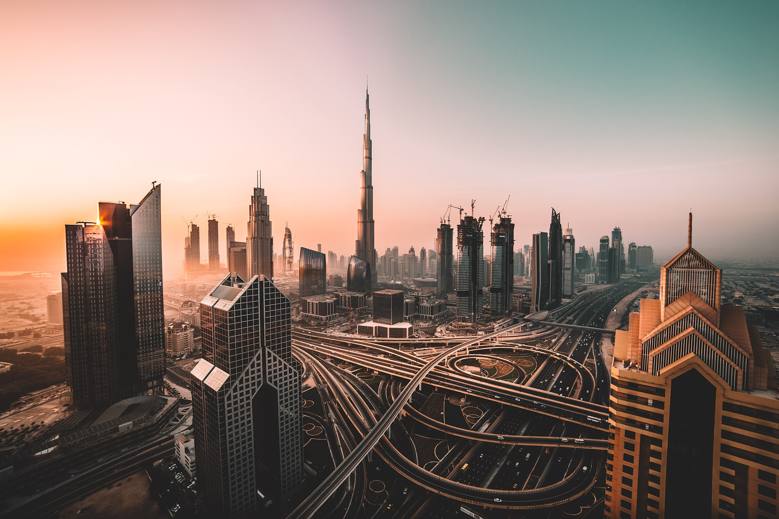
dubai
Dubai is a growing metropolis that is a business, shipping, and tourist hub.
Dubai has experienced a high rate of growth and expansion over the last decade.

Slide 4
Data sources
Two data sources
Foursquare API:
Names of venues
Categories of Venues
Location (Longitude & Latitude)
Urbanspoon (Zomato) API
Name of venues
Ratings (user generated)
Price range
Location (longitude & Latitude)
The data from both sources was combined into a single dataset

Slide 5
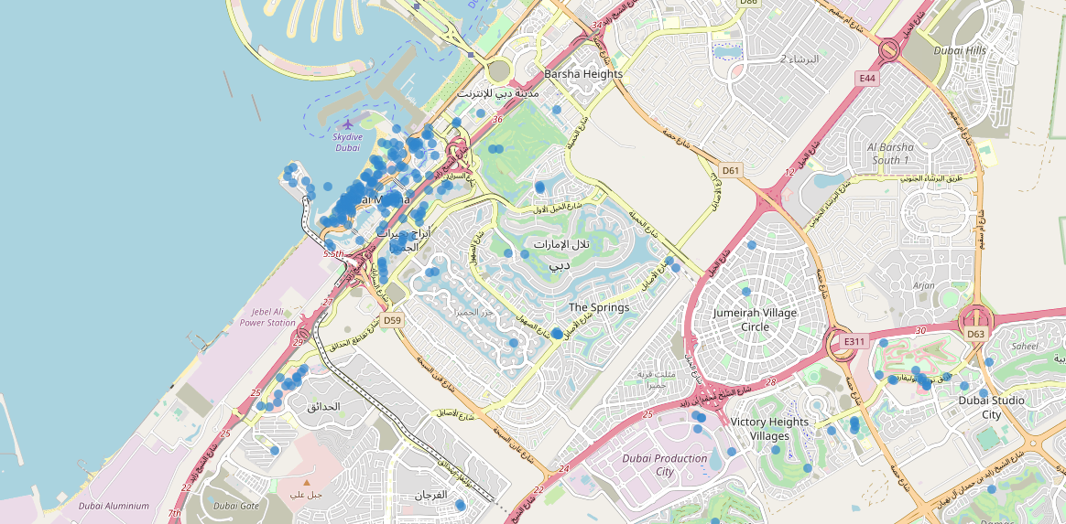
Foursquare map

Slide 6
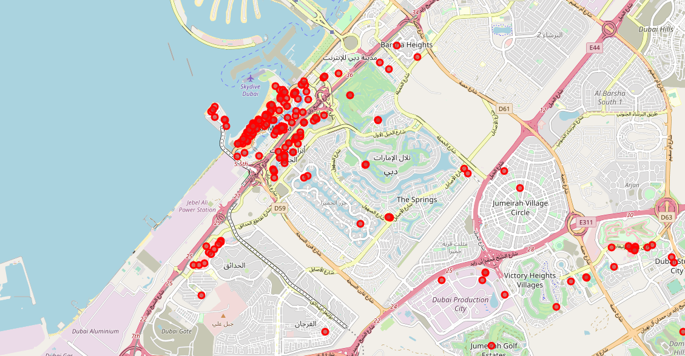
urbanspoon map
The two maps look similar, however data cleaning was undertaken and datasets merged

Slide 7
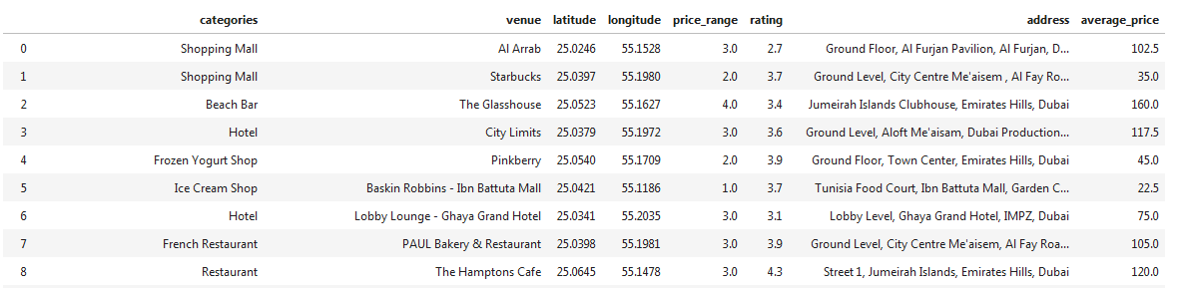
Combined dataset includes only elements needed for analysis

Slide 8
methodology
API data fetching
Data Exploration
Data Cleaning
Data visualization
Clustering (kmeans)

Slide 9
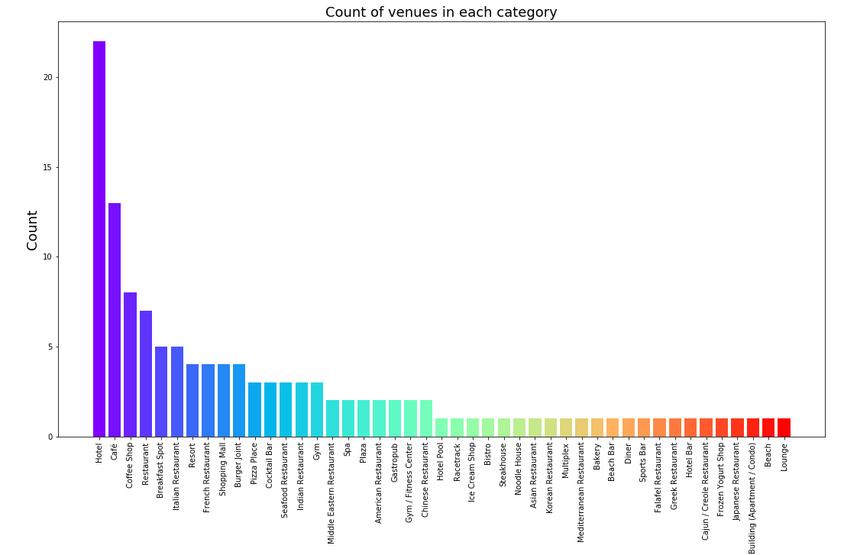
Data exploration example
Highest count of venues were hotels, restaurants, coffee shops

Slide 10
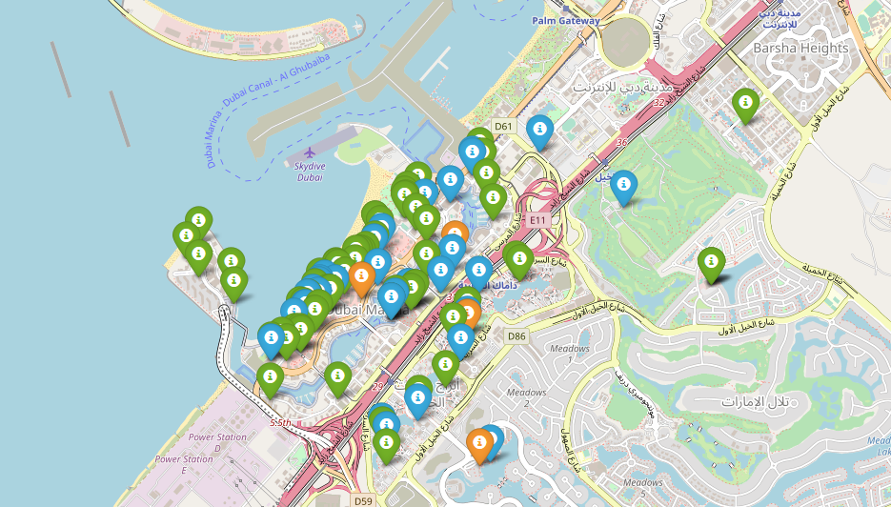
Data exploration example
Ratings of venues were mapped
It appeared that venues “clustered” in the Dubai Marina area (waterfront) and that those venues had reasonably high ratings (blue = very good; green = good)

Slide 11
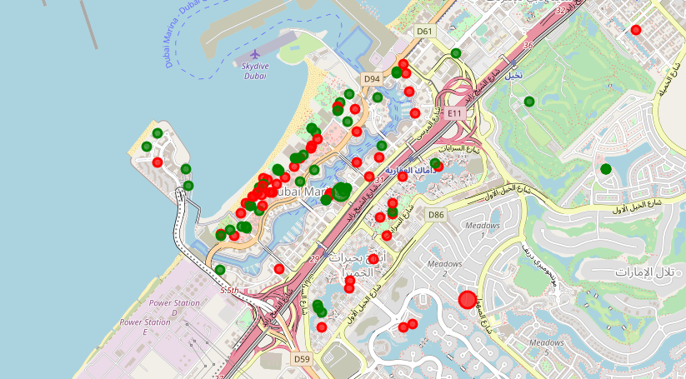
clustering
Two clusters were produced
Cluster 0 (red):
More expensive restaurants
Mostly located in hotels
Cluster 1 (green):
Lower priced
Mostly located in shopping malls

Slide 12
conclusion
Dubai has a wide range of venue options
Dubai Marina appears to be an area where there is a higher density of venues compared to other areas (Likely due to waterfront location)
Ratings for venues were similar in higher priced and lower priced venues, suggesting that Dubai has a wide option of well-rated venues that can be appealing to visitors
Business-Oriented individuals could possibly explore types of venues where less competition (lower count) exists such as lounges. They could also explore different areas and options regarding potential locations (hotels, malls, etc.)

